Slide 1
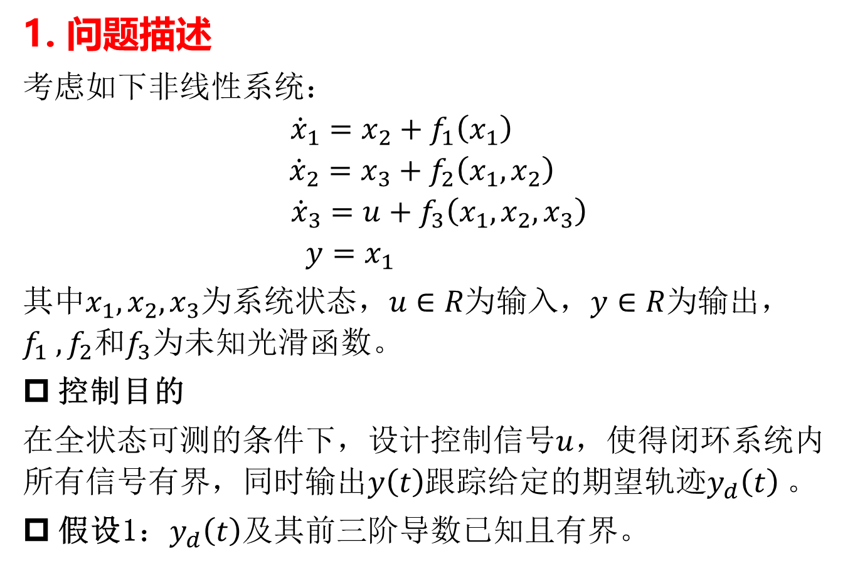
1. 问题描述
考虑如下非线性系统：
$${\dot{x}}_{1}=x_{2}+f_{1}\left(x_{1}\right)$$
$${\dot{x}}_{2}=x_{3}+f_{2}\left(x_{1},x_{2}\right)$$
$${\dot{x}}_{3}=u+f_{3}\left(x_{1},x_{2},x_{3}\right)$$
$$y=x_{1}$$
其中$x_{1},x_{2},x_{3}$为系统状态，$u∈R为$输入$，y∈R$为输出， $f_{1} ,f_{2}和f_{3}$为未知光滑函数。
控制目的
在全状态可测的条件下，设计控制信号$u$，使得闭环系统内所有信号有界，同时输出$y\left(t\right)$跟踪给定的期望轨迹$y_{d}\left(t\right)$。
假设1：$y_{d}\left(t\right)$及其前三阶导数已知且有界$。$

Slide 2
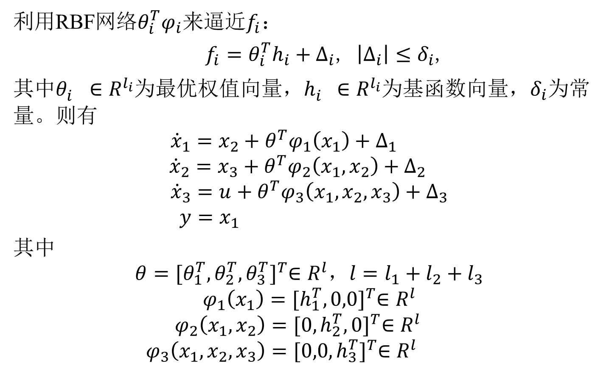
利用RBF网络$θ_{i}^{T}φ_{i}$来逼近$f_{i}$：
$f_{i}=θ_{i}^{T}h_{i}+∆_{i}$, $\left|∆_{i}\right|≤δ_{i}$,
其中$θ_{i}^{}∈R^{l_{i}}为最优权值向量，h_{i}^{}∈R^{l_{i}}为基函数向量，δ_{i}$为常量。则有
$${\dot{x}}_{1}=x_{2}+θ^{T}φ_{1}\left(x_{1}\right)+∆_{1}$$
$${\dot{x}}_{2}=x_{3}+θ^{T}φ_{2}\left(x_{1},x_{2}\right)+∆_{2}$$
$${\dot{x}}_{3}=u+θ^{T}φ_{3}\left(x_{1},x_{2},x_{3}\right)+∆_{3}$$
$$y=x_{1}$$
其中
$$θ{=[θ_{1}^{T},θ_{2}^{T},θ_{3}^{T}]}^{T}∈R^{l}，l=l_{1}+l_{2}+l_{3}$$
$$φ_{1}\left(x_{1}\right){=[h_{1}^{T},0,0]}^{T}∈R^{l}$$
$$φ_{2}\left(x_{1},x_{2}\right){=[{0,h}_{2}^{T}, 0]}^{T}∈R^{l}$$
$$φ_{3}\left(x_{1},x_{2},x_{3}\right){=[{0,0,h}_{3}^{T}]}^{T}∈R^{l}$$

Slide 3
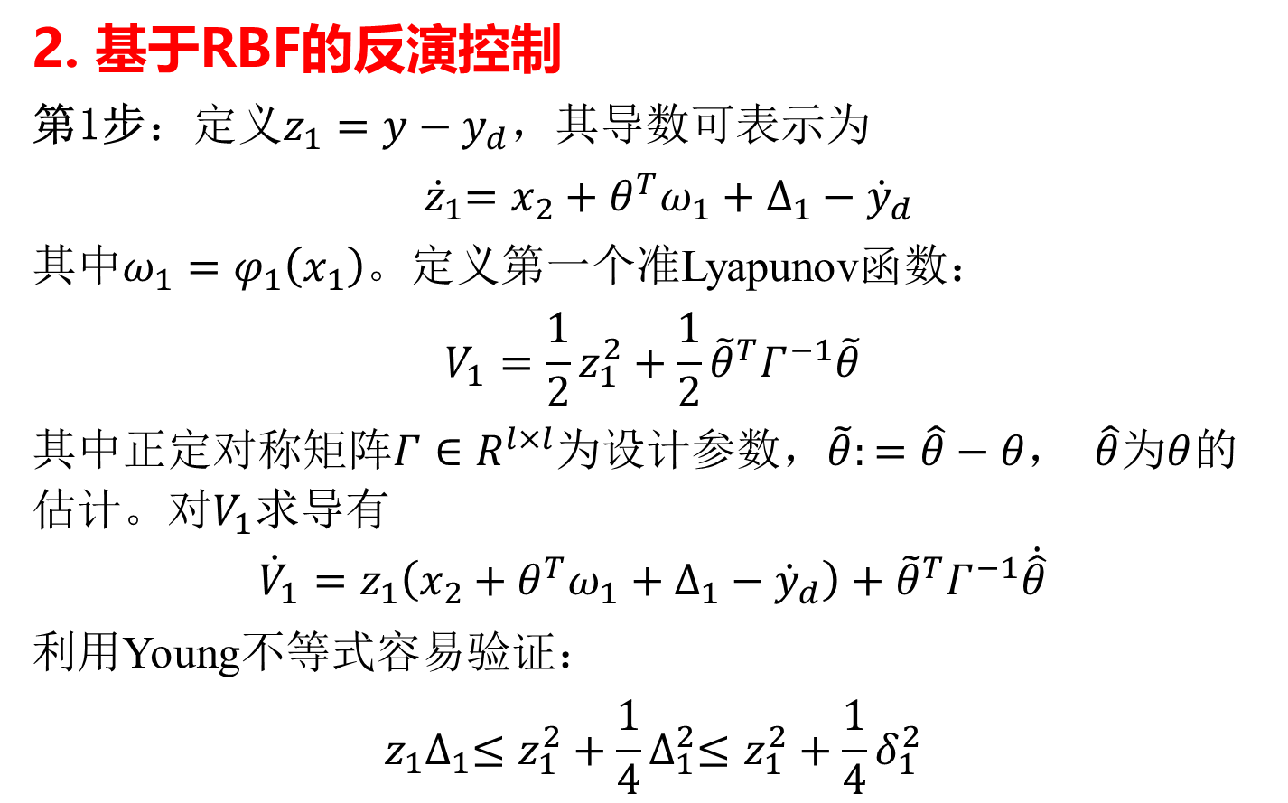
2. 基于RBF的反演控制
第1步：定义${z_{1}=y−y}_{d}$，其导数可表示为
${ \dot{z}}_{1}=x_{2}+θ^{T}ω_{1}+∆_{1}−{\dot{y}}_{d}$
$其中ω_{1}=φ_{1}\left(x_{1}\right)$。定义第一个准Lyapunov函数：
$$V_{1}=\frac{1}{2}z_{1}^{2}+\frac{1}{2}{\tilde{θ}}^{T}Γ^{−1}\tilde{θ}$$
其中$\text{正定对称矩阵}Γ∈R^{l×l}$为设计参数，$\tilde{θ}:=\hat{θ}−θ$， $\hat{θ}$为$θ$的估计。对$V_{1}$求导有
$${\dot{V}}_{1}=z_{1}\left(x_{2}+θ^{T}ω_{1}+∆_{1}−{\dot{y}}_{d}\right)+{\tilde{θ}}^{T}Γ^{−1}\dot{\hat{θ}}$$
利用Young不等式容易验证：
$$z_{1}∆_{1}≤z_{1}^{2}+\frac{1}{4}∆_{1}^{2}≤z_{1}^{2}+\frac{1}{4}δ_{1}^{2}$$

Slide 4
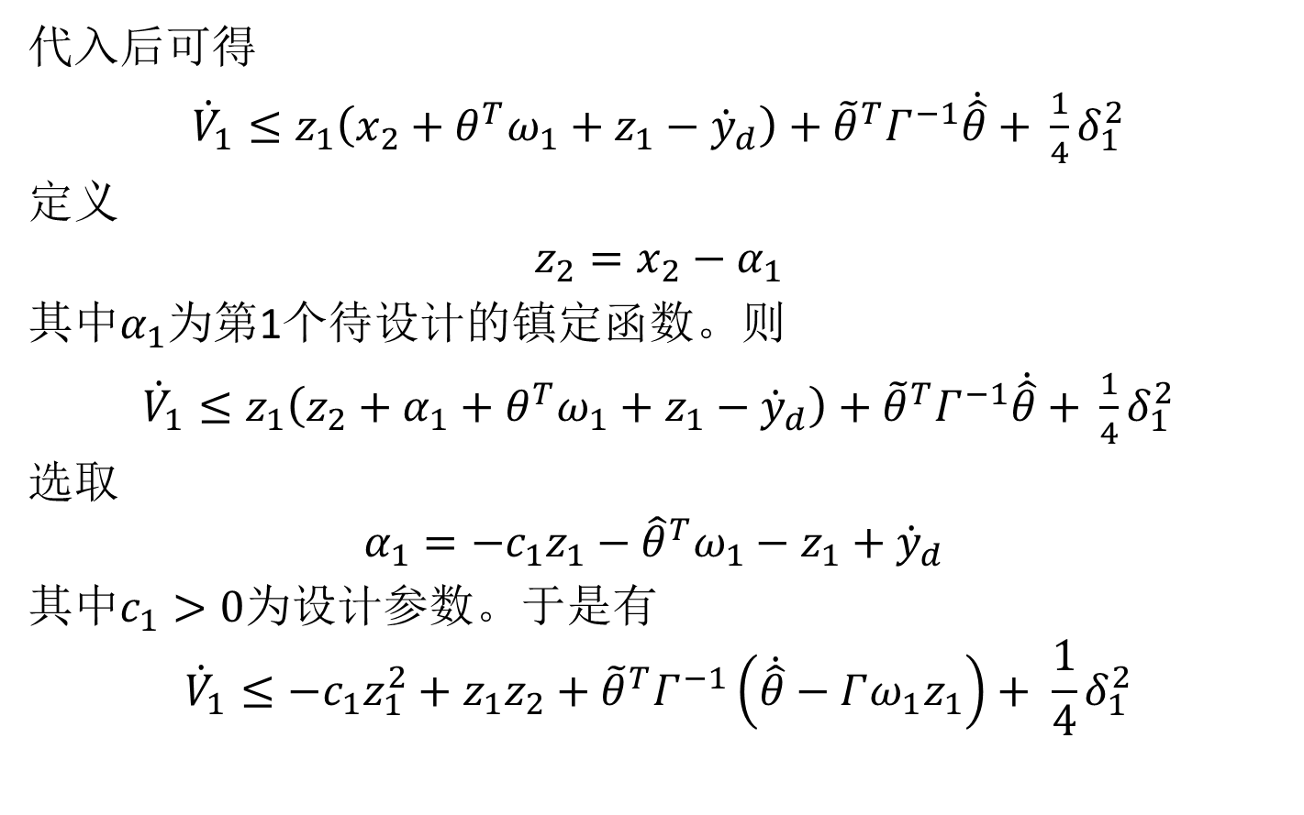
代入后可得
${\dot{V}}_{1}≤z_{1}\left(x_{2}+θ^{T}ω_{1}+z_{1}−{\dot{y}}_{d}\right)+{\tilde{θ}}^{T}Γ^{−1}\dot{\hat{θ}}$ $+ \frac{1}{4}δ_{1}^{2}$
定义
$$z_{2}=x_{2}−α_{1}$$
其中$α_{1}$为第1个待设计的镇定函数。则
${\dot{V}}_{1}≤z_{1}\left(z_{2}+α_{1}+θ^{T}ω_{1}+z_{1}−{\dot{y}}_{d}\right)+{\tilde{θ}}^{T}Γ^{−1}\dot{\hat{θ}}$ $+ \frac{1}{4}δ_{1}^{2}$
选取
$$α_{1}=−c_{1}z_{1}−{\hat{θ}}^{T}ω_{1}−z_{1}+{\dot{y}}_{d}$$
其中$c_{1}>0$为设计参数。于是有
$${\dot{V}}_{1}≤−c_{1}z_{1}^{2}+z_{1}z_{2}+{\tilde{θ}}^{T}Γ^{−1}\left(\dot{\hat{θ}}−Γω_{1}z_{1}\right)+ \frac{1}{4}δ_{1}^{2}$$

Slide 5
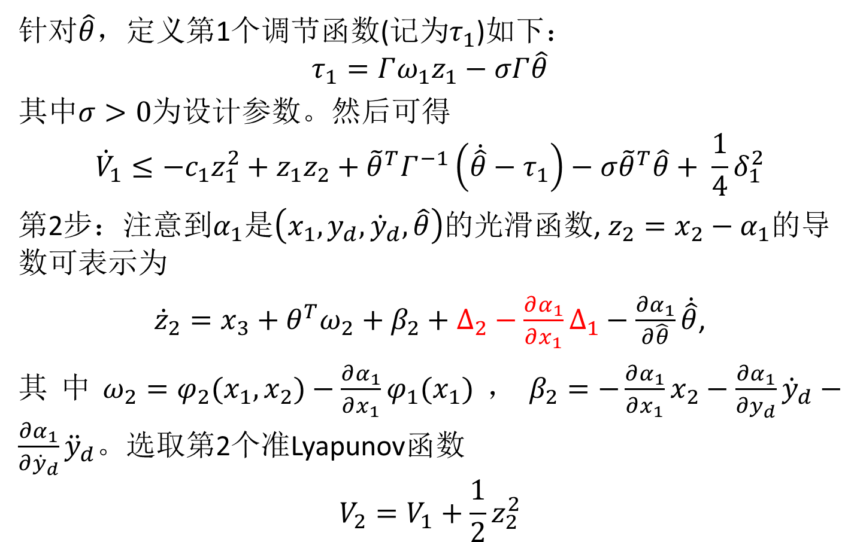
针对$\hat{θ}$，定义第1个调节函数(记为$τ_{1}$)如下：
$$τ_{1}=Γω_{1}z_{1}−σΓ\hat{θ}$$
其中$σ>0$为设计参数。然后可得
$${\dot{V}}_{1}≤−c_{1}z_{1}^{2}+z_{1}z_{2}+{\tilde{θ}}^{T}Γ^{−1}\left(\dot{\hat{θ}}−τ_{1}\right)−σ{\tilde{θ}}^{T}\hat{θ}+ \frac{1}{4}δ_{1}^{2}$$
第2步：注意到$α_{1}$是$\left(x_{1},y_{d},{\dot{y}}_{d},\hat{θ}\right)$的光滑函数, $z_{2}=x_{2}−α_{1}$的导数可表示为
${\dot{z}}_{2}=x_{3}+θ^{T}ω_{2}+$ $β_{2}+∆_{2}−\frac{∂α_{1}}{∂x_{1}}∆_{1}−\frac{∂α_{1}}{∂\hat{θ}}\dot{\hat{θ}}$,
其中$ω_{2}=φ_{2}(x_{1},x_{2})−\frac{∂α_{1}}{∂x_{1}}φ_{1}(x_{1})$，$β_{2}=−\frac{∂α_{1}}{∂x_{1}}x_{2}−\frac{∂α_{1}}{∂y_{d}}{\dot{y}}_{d}−\frac{∂α_{1}}{∂{\dot{y}}_{d}}{\ddot{y}}_{d}$。选取第2个准Lyapunov函数
$$V_{2}=V_{1}+\frac{1}{2}z_{2}^{2}$$

Slide 6
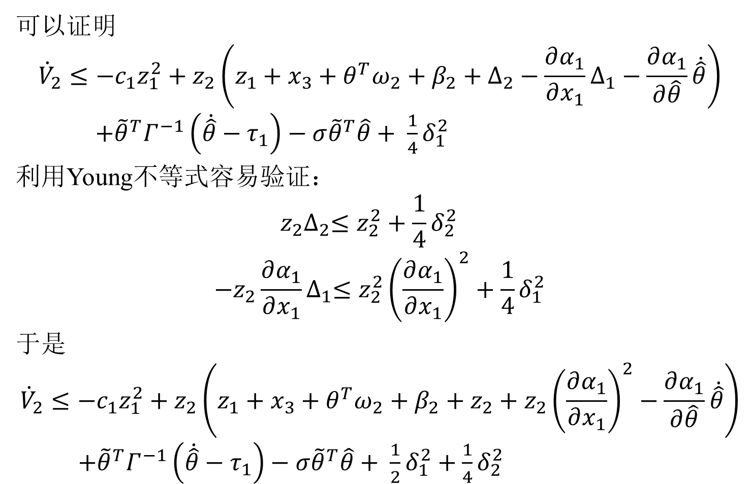
可以证明
$${\dot{V}}_{2}≤−c_{1}z_{1}^{2}+z_{2}\left(z_{1}+x_{3}+θ^{T}ω_{2}+β_{2}+∆_{2}−\frac{∂α_{1}}{∂x_{1}}∆_{1}−\frac{∂α_{1}}{∂\hat{θ}}\dot{\hat{θ}}\right)$$
$+{\tilde{θ}}^{T}Γ^{−1}\left(\dot{\hat{θ}}−τ_{1}\right)−σ{\tilde{θ}}^{T}\hat{θ}+ \frac{1}{4}δ_{1}^{2}$
利用Young不等式容易验证：
$$z_{2}∆_{2}≤z_{2}^{2}+\frac{1}{4}δ_{2}^{2}$$
$$−z_{2}\frac{∂α_{1}}{∂x_{1}}∆_{1}≤z_{2}^{2}{\left(\frac{∂α_{1}}{∂x_{1}}\right)}^{2}+\frac{1}{4}δ_{1}^{2}$$
于是
$${\dot{V}}_{2}≤−c_{1}z_{1}^{2}+z_{2}\left(z_{1}+x_{3}+θ^{T}ω_{2}+β_{2}+z_{2}+z_{2}{\left(\frac{∂α_{1}}{∂x_{1}}\right)}^{2}−\frac{∂α_{1}}{∂\hat{θ}}\dot{\hat{θ}}\right)$$
$+{\tilde{θ}}^{T}Γ^{−1}\left(\dot{\hat{θ}}−τ_{1}\right)−σ{\tilde{θ}}^{T}\hat{θ}+ \frac{1}{2}δ_{1}^{2}+\frac{1}{4}δ_{2}^{2}$

Slide 7
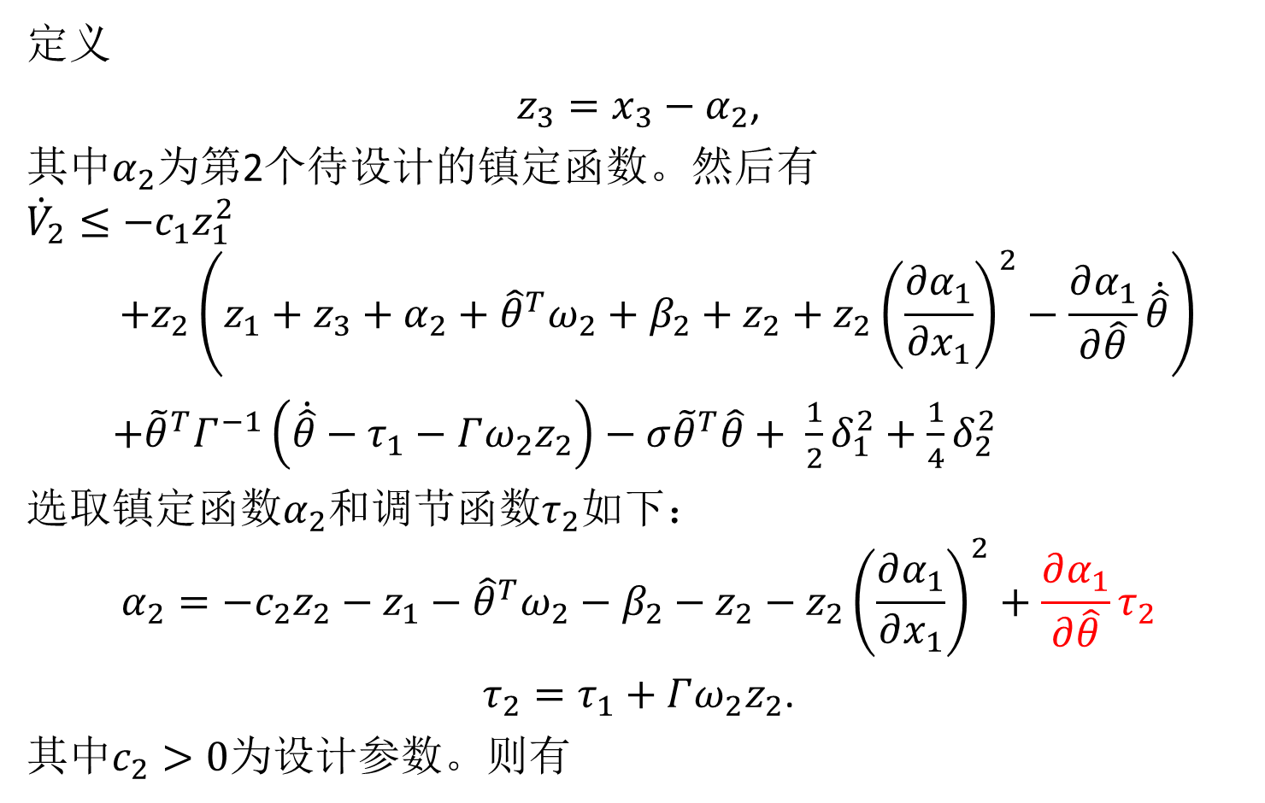
定义
$z_{3}=x_{3}−α_{2}$,
其中$α_{2}$为第2个待设计的镇定函数。然后有
$${\dot{V}}_{2}≤−c_{1}z_{1}^{2}$$
$$+z_{2}\left(z_{1}+z_{3}+α_{2}+{\hat{θ}}^{T}ω_{2}+β_{2}+z_{2}+z_{2}{\left(\frac{∂α_{1}}{∂x_{1}}\right)}^{2}−\frac{∂α_{1}}{∂\hat{θ}}\dot{\hat{θ}}\right)$$
$+{\tilde{θ}}^{T}Γ^{−1}\left(\dot{\hat{θ}}−τ_{1}−Γω_{2}z_{2}\right)−σ{\tilde{θ}}^{T}\hat{θ}+ \frac{1}{2}δ_{1}^{2}+\frac{1}{4}δ_{2}^{2}$
选取镇定函数$α_{2}$和调节函数$τ_{2}$如下：
$$α_{2}=−c_{2}z_{2}−z_{1}−{\hat{θ}}^{T}ω_{2}−β_{2}−z_{2}−z_{2}{\left(\frac{∂α_{1}}{∂x_{1}}\right)}^{2}+\frac{∂α_{1}}{∂\hat{θ}}τ_{2}$$
$τ_{2}=τ_{1}+Γω_{2}z_{2}$.
其中$c_{2}>0$为设计参数。则有

Slide 8
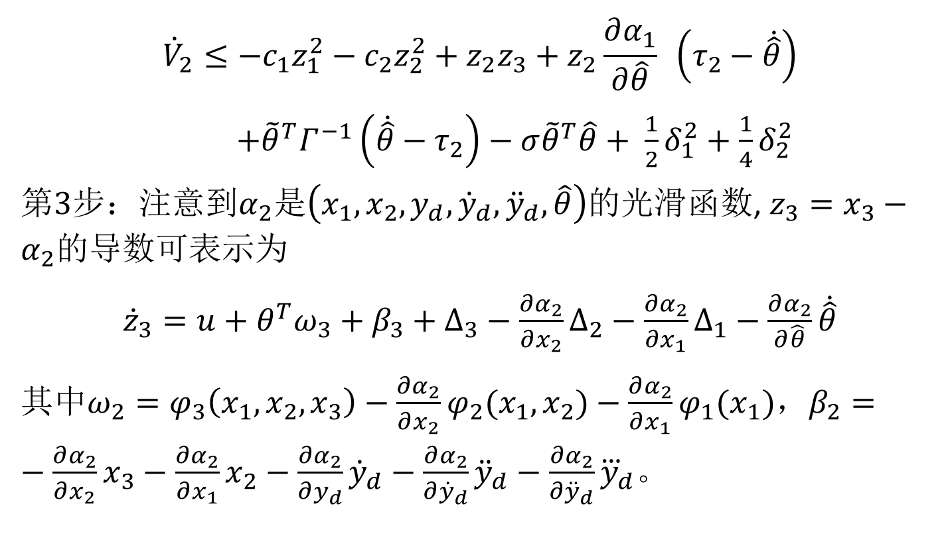
$${\dot{V}}_{2}≤−c_{1}z_{1}^{2}−c_{2}z_{2}^{2}+z_{2}z_{3}+z_{2}\frac{∂α_{1}}{∂\hat{θ}} （τ_{2}−\dot{\hat{θ}}）$$
$+{\tilde{θ}}^{T}Γ^{−1}\left(\dot{\hat{θ}}−τ_{2}\right)−σ{\tilde{θ}}^{T}\hat{θ}+ \frac{1}{2}δ_{1}^{2}+\frac{1}{4}δ_{2}^{2}$
第$3$步：注意到$α_{2}$是$\left(x_{1},{x_{2},y}_{d},{\dot{y}}_{d},{\ddot{y}}_{d},\hat{θ}\right)$的光滑函数, $z_{3}=x_{3}−α_{2}$的导数可表示为
${\dot{z}}_{3}=u+θ^{T}ω_{3}+$ $β_{3}+∆_{3}−\frac{∂α_{2}}{∂x_{2}}∆_{2}−\frac{∂α_{2}}{∂x_{1}}∆_{1}−\frac{∂α_{2}}{∂\hat{θ}}\dot{\hat{θ}}$
其中$ω_{2}={φ_{3}\left(x_{1},x_{2},x_{3}\right)−\frac{∂α_{2}}{∂x_{2}}φ}_{2}(x_{1},x_{2})−\frac{∂α_{2}}{∂x_{1}}φ_{1}(x_{1})$，$β_{2}=−\frac{∂α_{2}}{∂x_{2}}x_{3}−\frac{∂α_{2}}{∂x_{1}}x_{2}−\frac{∂α_{2}}{∂y_{d}}{\dot{y}}_{d}−\frac{∂α_{2}}{∂{\dot{y}}_{d}}{\ddot{y}}_{d}−\frac{∂α_{2}}{∂{\ddot{y}}_{d}}{\overset{⃛}{y}}_{d}$。

Slide 9
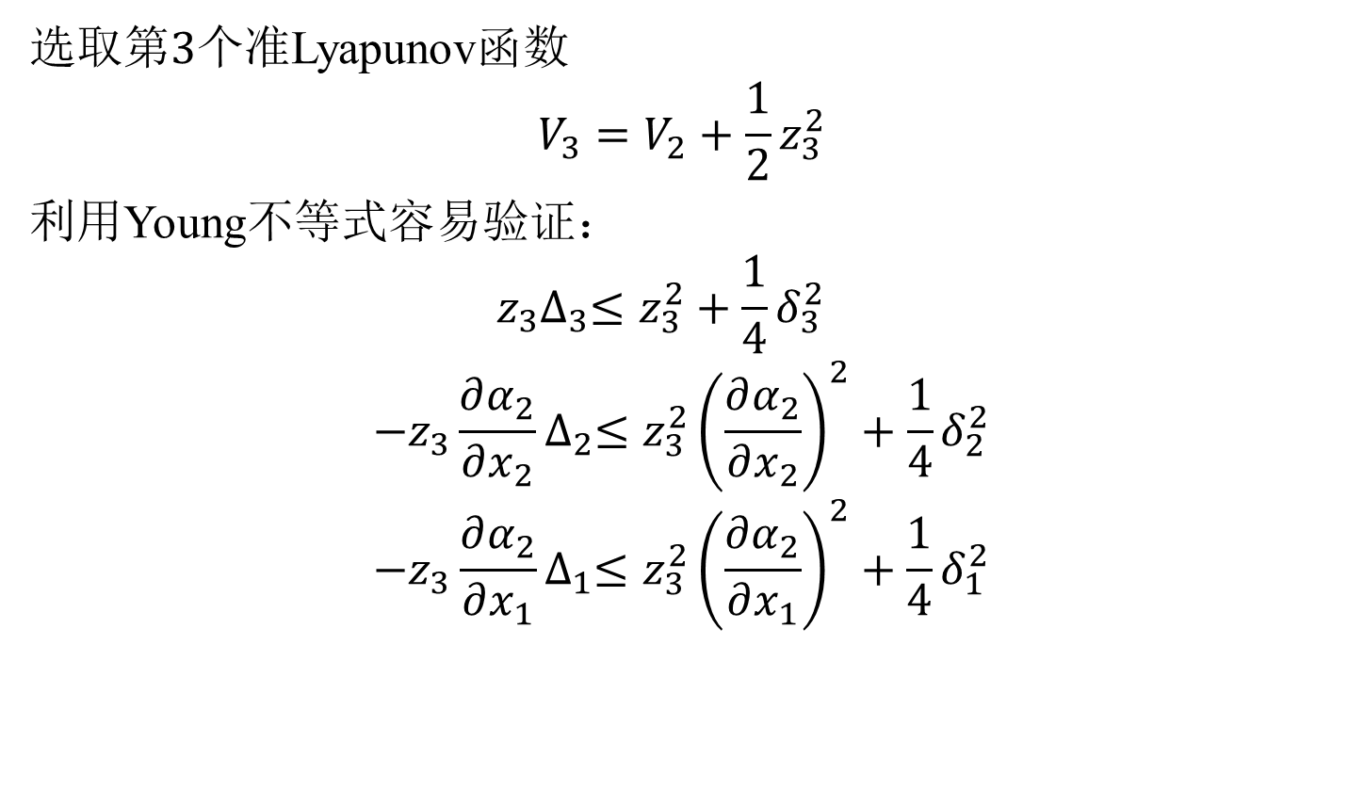
选取第$3$个准Lyapunov函数
$$V_{3}=V_{2}+\frac{1}{2}z_{3}^{2}$$
利用Young不等式容易验证：
$$z_{3}∆_{3}≤z_{3}^{2}+\frac{1}{4}δ_{3}^{2}$$
$$−z_{3}\frac{∂α_{2}}{∂x_{2}}∆_{2}≤z_{3}^{2}{\left(\frac{∂α_{2}}{∂x_{2}}\right)}^{2}+\frac{1}{4}δ_{2}^{2}$$
$$−z_{3}\frac{∂α_{2}}{∂x_{1}}∆_{1}≤z_{3}^{2}{\left(\frac{∂α_{2}}{∂x_{1}}\right)}^{2}+\frac{1}{4}δ_{1}^{2}$$

Slide 10
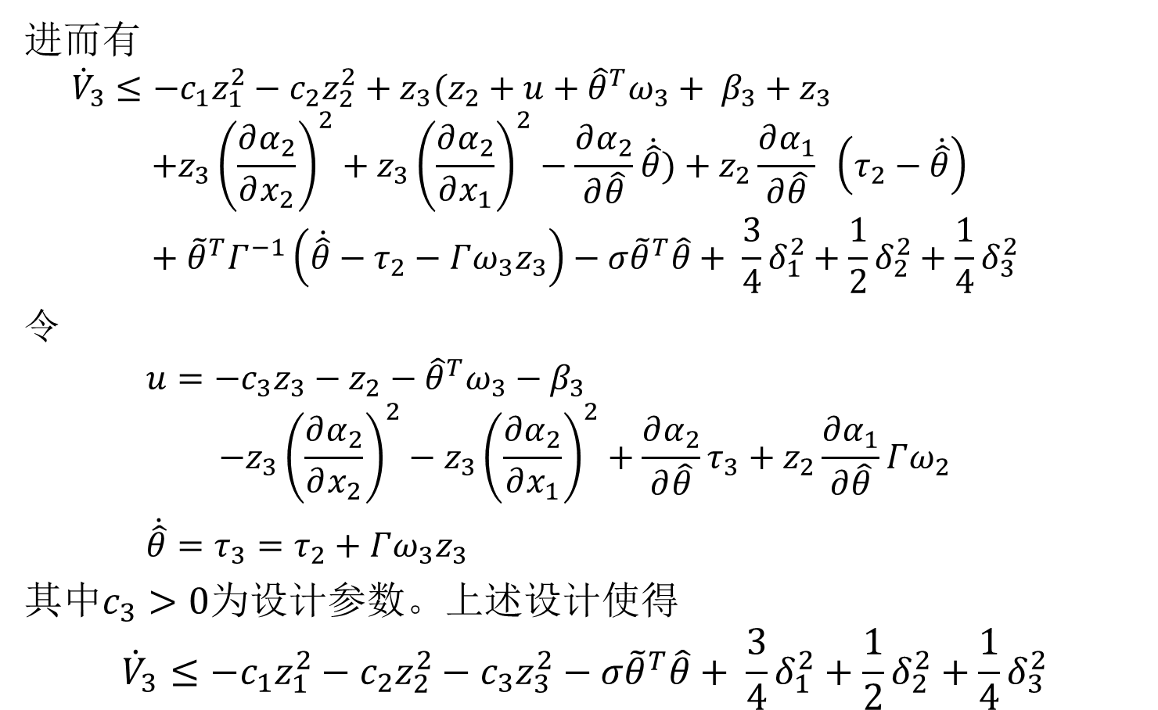
进而有
$${\dot{V}}_{3}≤−c_{1}z_{1}^{2}−c_{2}z_{2}^{2}+{z_{3}(z}_{2}+u+{\hat{θ}}^{T}ω_{3}+ β_{3}+z_{3}$$
$$+{z_{3}\left(\frac{∂α_{2}}{∂x_{2}}\right)}^{2}+{z_{3}\left(\frac{∂α_{2}}{∂x_{1}}\right)}^{2}−\frac{∂α_{2}}{∂\hat{θ}}\dot{\hat{θ}})+z_{2}\frac{∂α_{1}}{∂\hat{θ}} （τ_{2}−\dot{\hat{θ}}）+{\tilde{θ}}^{T}Γ^{−1}\left(\dot{\hat{θ}}−τ_{2}−Γω_{3}z_{3}\right)−σ{\tilde{θ}}^{T}\hat{θ}+ \frac{3}{4}δ_{1}^{2}+\frac{1}{2}δ_{2}^{2}+\frac{1}{4}δ_{3}^{2}$$
令
$u=−c_{3}z_{3}−z_{2}−{\hat{θ}}^{T}ω_{3}−β_{3}$
$$−{z_{3}\left(\frac{∂α_{2}}{∂x_{2}}\right)}^{2}−{z_{3}\left(\frac{∂α_{2}}{∂x_{1}}\right)}^{2}+\frac{∂α_{2}}{∂\hat{θ}}τ_{3}+z_{2}\frac{∂α_{1}}{∂\hat{θ}}Γω_{2}$$
$\dot{\hat{θ}}={τ_{3}=τ}_{2}+Γω_{3}z_{3}$
其中$c_{3}>0$为设计参数。上述设计使得
$${\dot{V}}_{3}≤−c_{1}z_{1}^{2}−c_{2}z_{2}^{2}−c_{3}z_{3}^{2}−σ{\tilde{θ}}^{T}\hat{θ}+ \frac{3}{4}δ_{1}^{2}+\frac{1}{2}δ_{2}^{2}+\frac{1}{4}δ_{3}^{2}$$

Slide 11
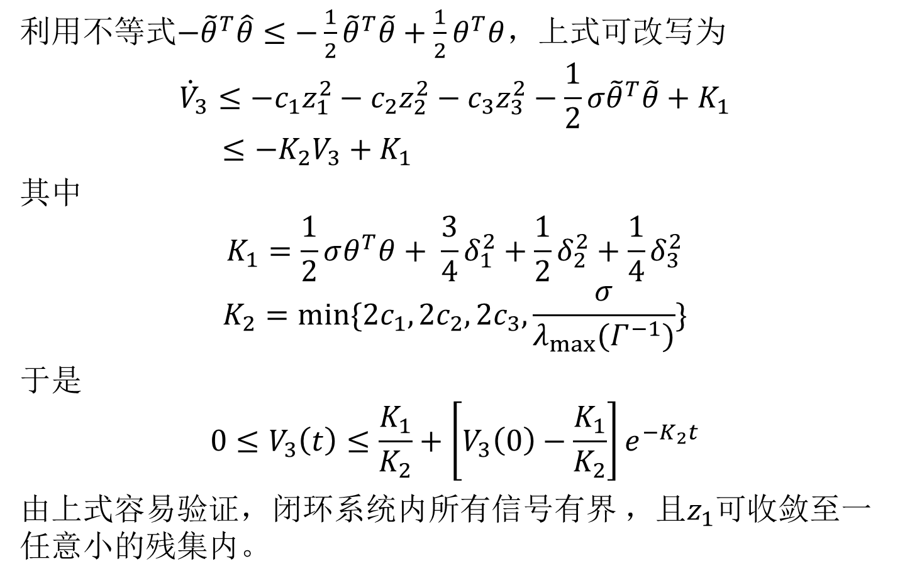
利用不等式$−{\tilde{θ}}^{T}\hat{θ}≤−\frac{1}{2}{\tilde{θ}}^{T}\tilde{θ}+\frac{1}{2}θ^{T}θ$，上式可改写为
$${\dot{V}}_{3}≤−c_{1}z_{1}^{2}−c_{2}z_{2}^{2}−c_{3}z_{3}^{2}−\frac{1}{2}σ{\tilde{θ}}^{T}\tilde{θ}+Κ_{1}$$
$$≤−Κ_{2}V_{3}+Κ_{1}$$
其中
$$Κ_{1}=\frac{1}{2}σθ^{T}θ+ \frac{3}{4}δ_{1}^{2}+\frac{1}{2}δ_{2}^{2}+\frac{1}{4}δ_{3}^{2}$$
$$Κ_{2}=min⁡\{2c_{1},2c_{2},2c_{3},\frac{σ}{λ_{max}(Γ^{−1})}\}$$
于是
$$0≤V_{3}\left(t\right)≤\frac{Κ_{1}}{Κ_{2}}+\left[V_{3}\left(0\right)−\frac{Κ_{1}}{Κ_{2}}\right]e^{−Κ_{2}t}$$
由$上式容易验证，闭环系统内所有信号有界$，且$z_{1}可$收敛至一任意小的残集内。

